Slide 1
Analysis of Target Customers for a Bike company
File created on: 8/28/2023 8:49:56 AM

Slide 2
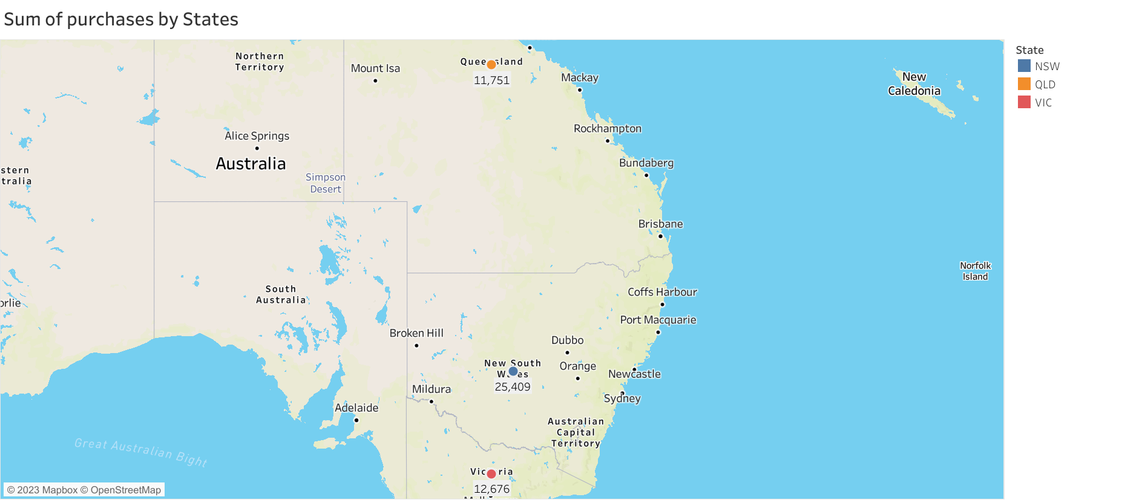

Slide 3
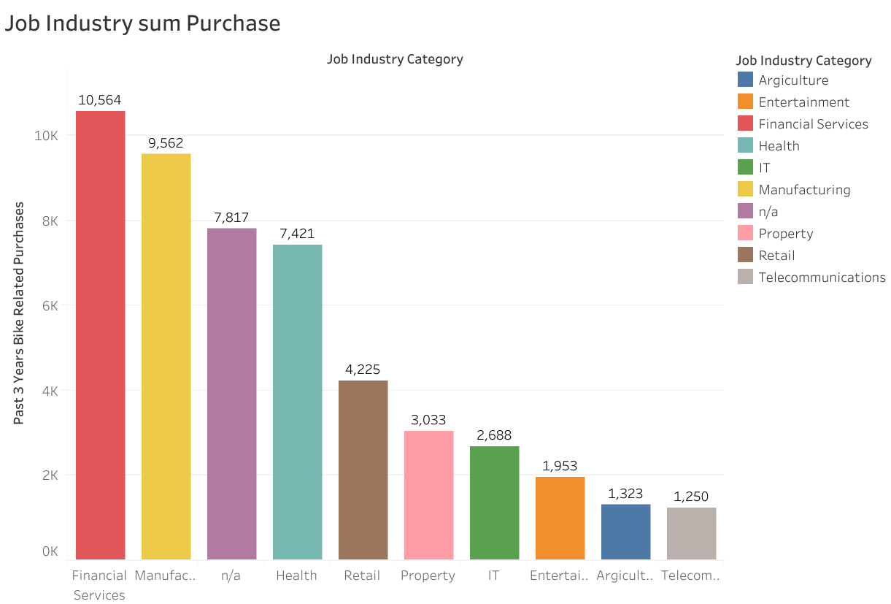

Slide 4
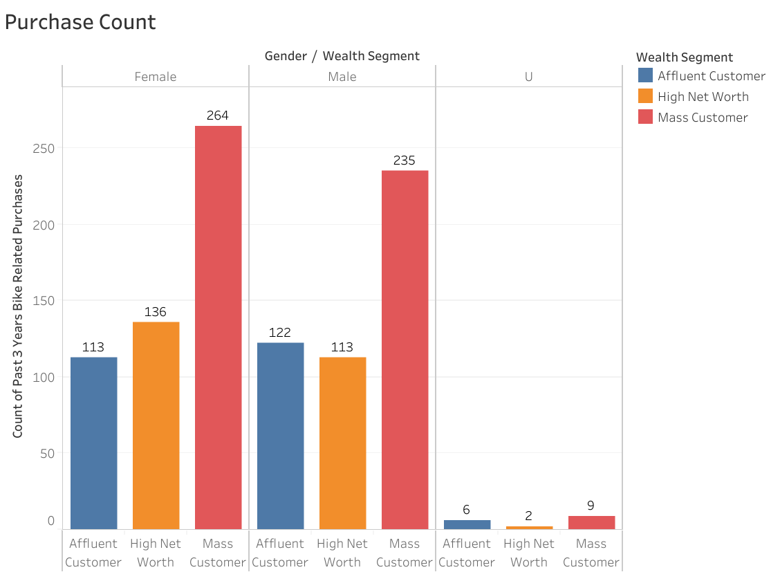

Slide 5
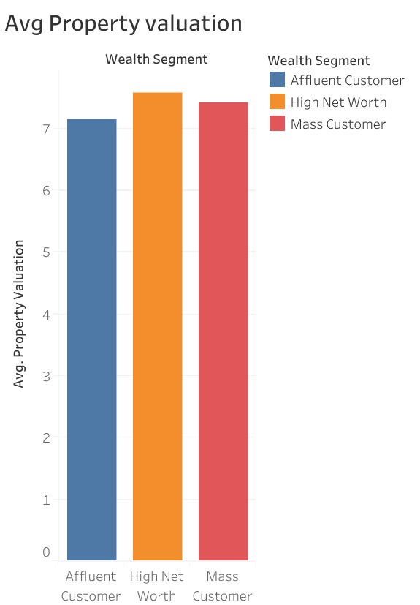

Slide 6
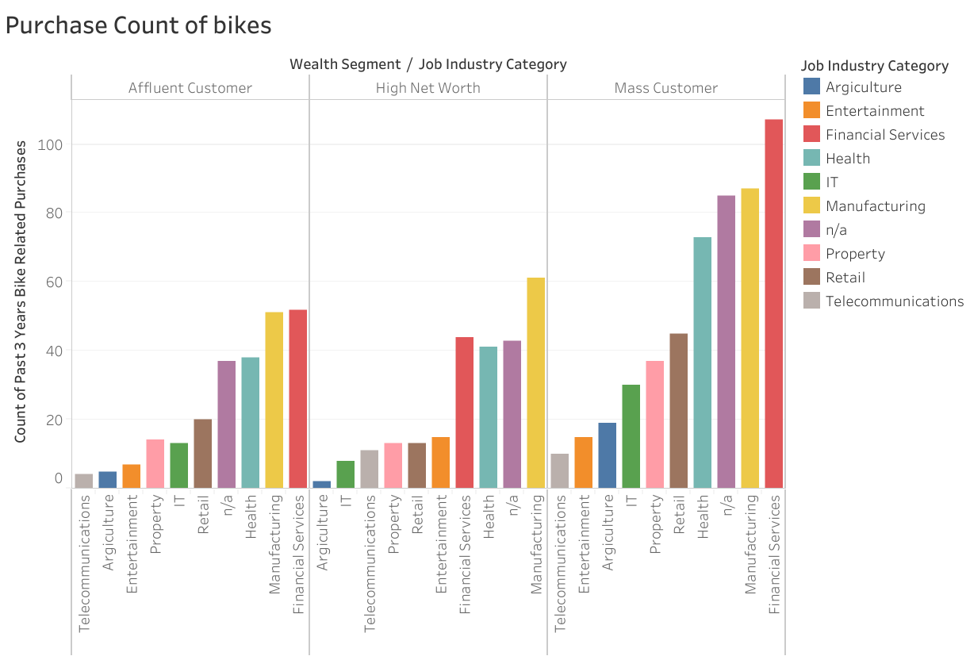

Slide 7
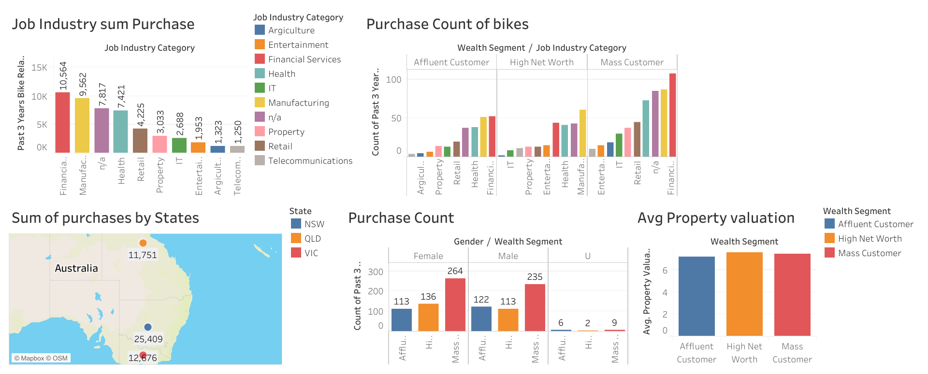

Slide 8
Analysis of quantitative and qualitative data
wealth segment | Number of customers | % | Number of bikes purchases | % | % difference sales minus no of customers
Mass | 508 | 50.8 | 25115 | 50.40 | -0.40
High net worth | 251 | 25.1 | 12716 | 25.52 | 0.42
Affluent | 241 | 24.1 | 12005 | 24.09 | -0.01
total | 1000 | 100 | 49836 | 100

Slide 9
Review of Analysis of Target customers on dashboard
From the visualization of data of the 1000 customers on the dashboard, Sprocket Central Pty Ltd should target customers that are:
Of the High net worth customers representing 25% of the total customer count, with job industry – manufacturing, n/a and health and also due to their highest property valuation.
The mass customers representing 51% of the customers count especially those in the financial sector, manufacturing and health.
And customers residing in New South Wales(NSW) of Australia who had a total purchase of 51% of the total number of bike purchases in the last 3 years.

Slide 10
THANK YOU
COPY LINK BELOW AND SEARCH ON BROWERS FOR MORE DETAILS ON DASHBOARD
https://us-west-2b.online.tableau.com/#/site/visualizationontableau/views/AnalysisofTargetCustomersforaBikecompany/Dashboard1?:iid=4

